Slide 1

Team Details
Team name: Skillers@IIITB
Team leader name: Aishwarya Sharma
Which domain does your idea address? (Agriculture / Healthcare / Skilling / Education): Skilling
(Note: The above information should be exactly same as submitted during the idea submission phase)

Slide 2
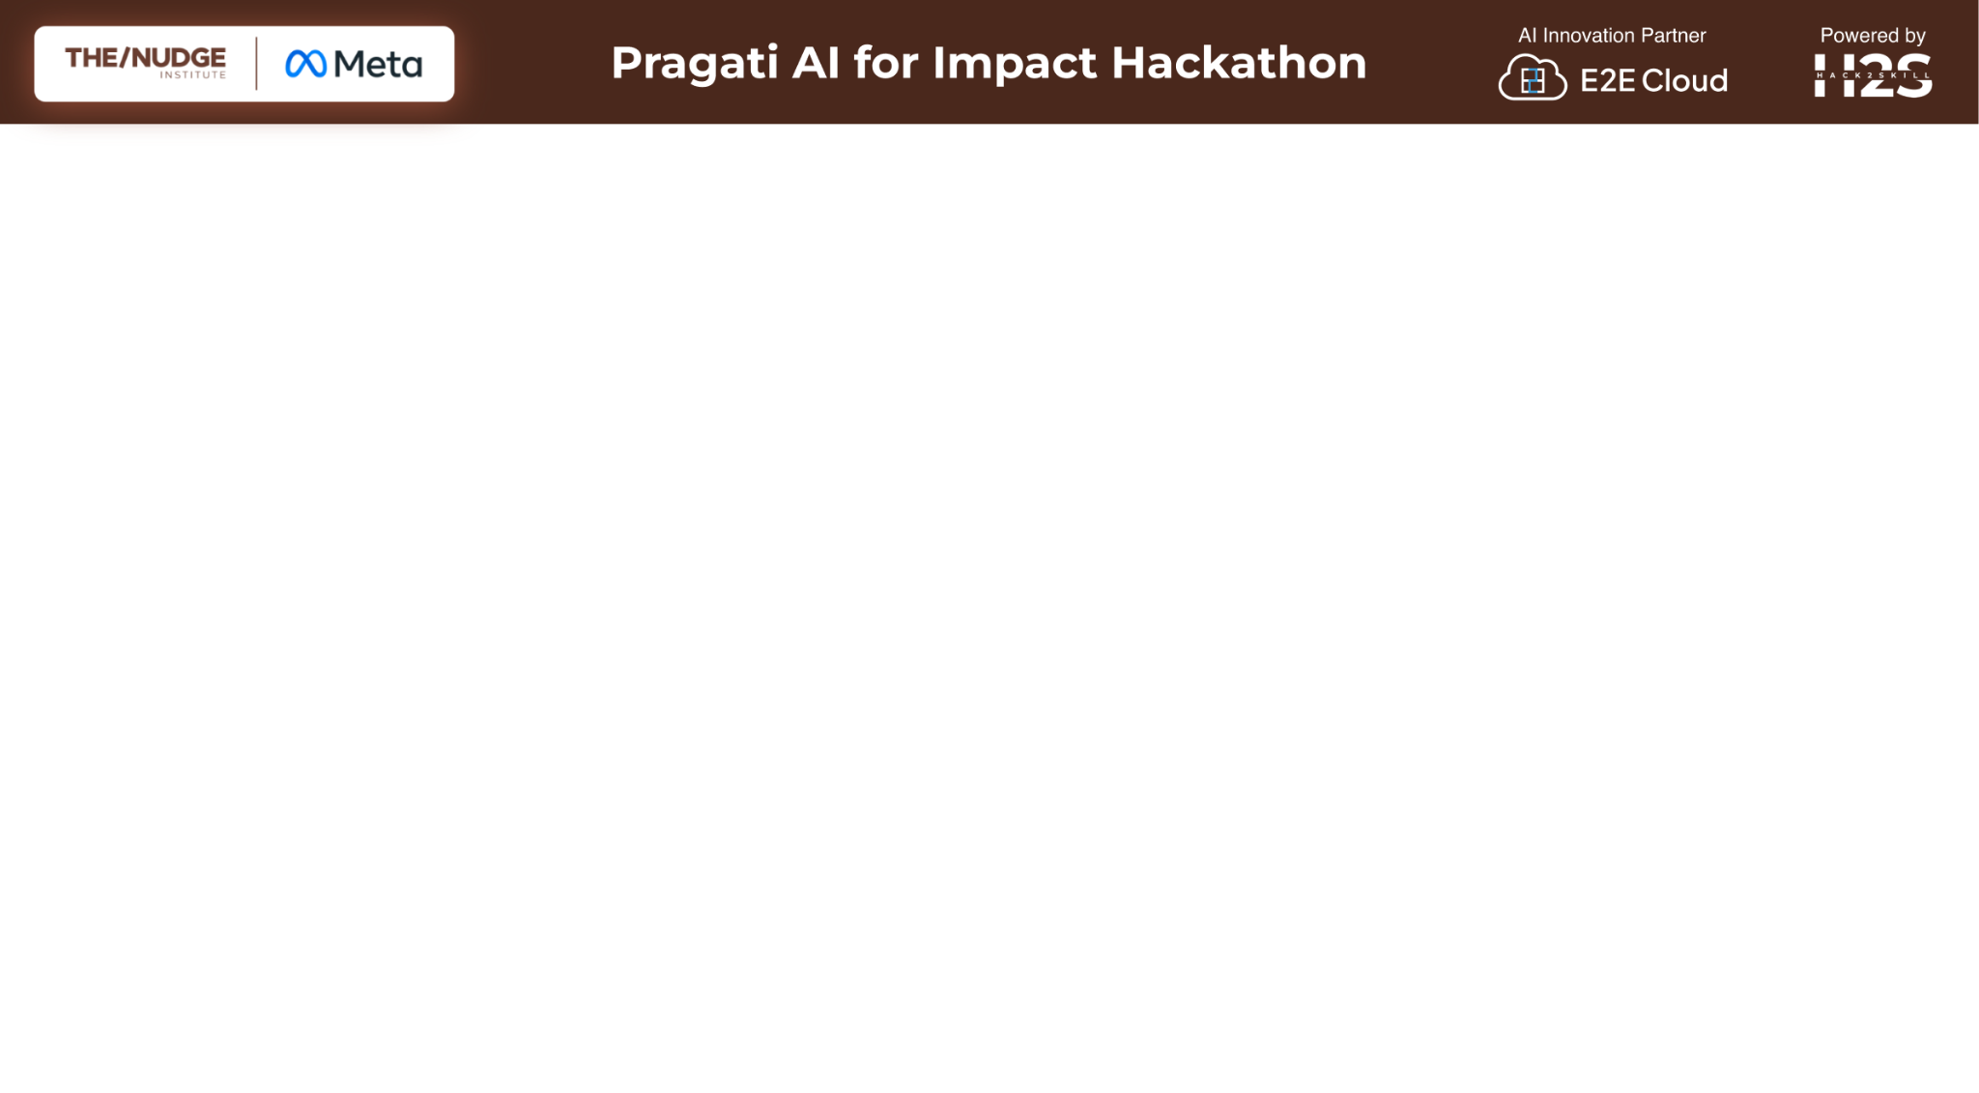
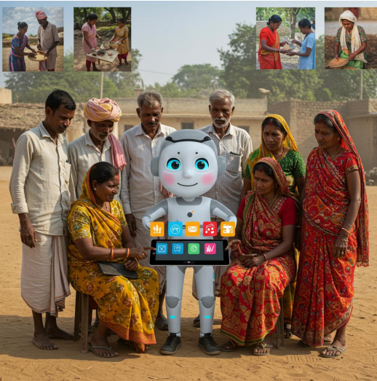
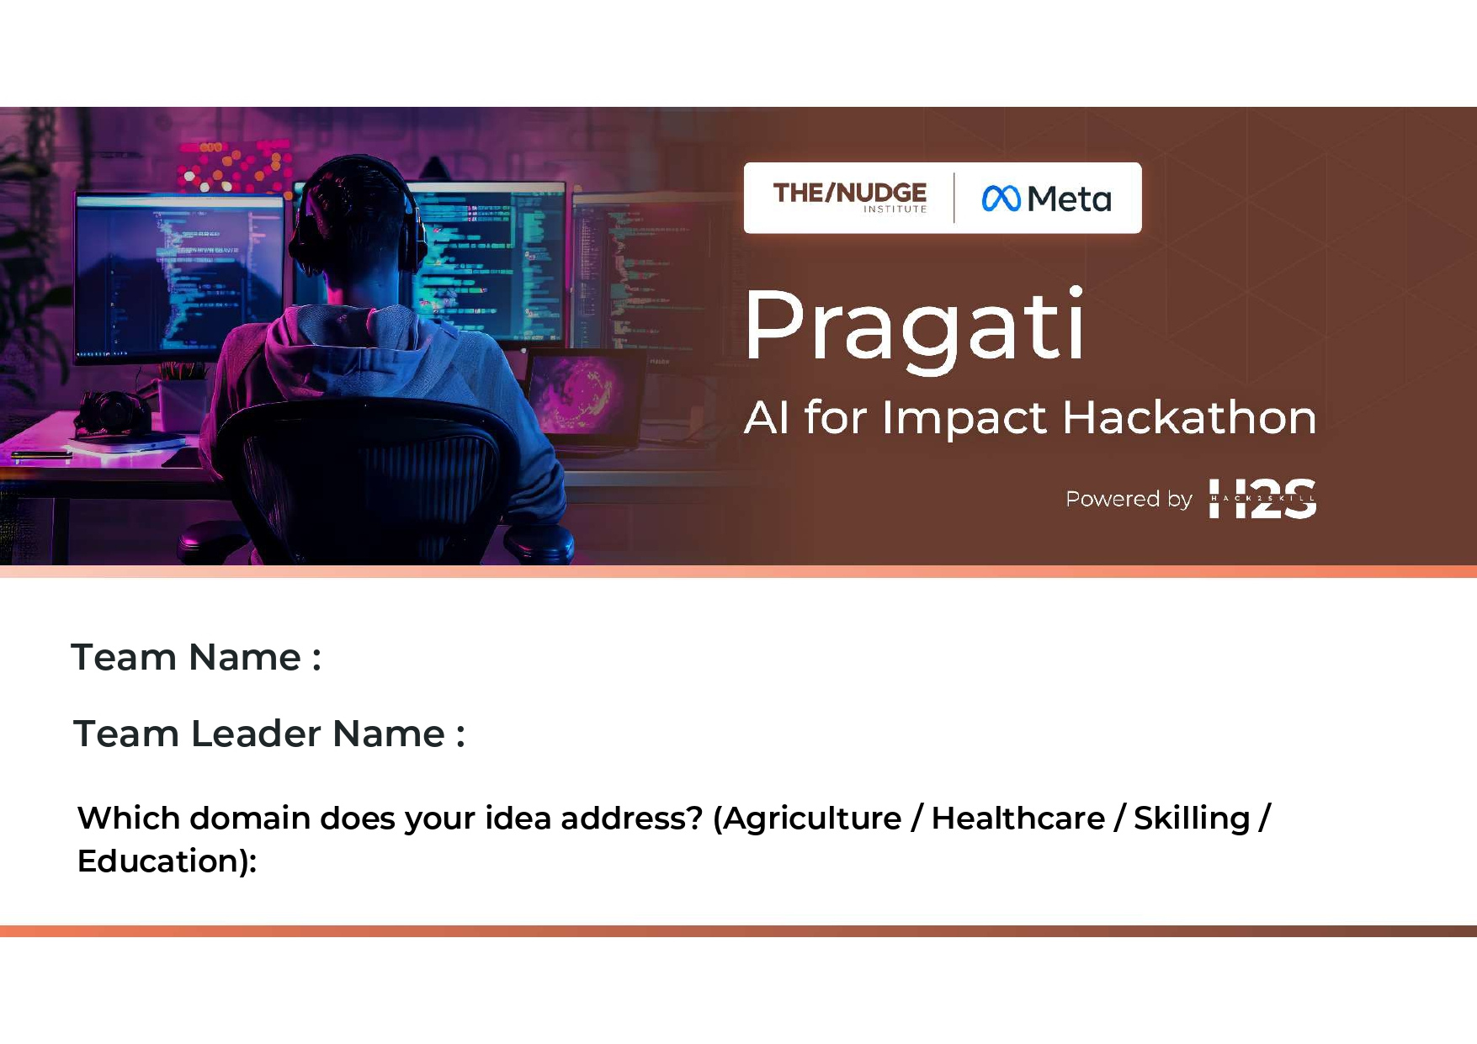
What is the problem you are solving? (50 words max)
Many underprivileged individuals in small villages or towns lack access to business opportunities, skill development, and professional networks. Current solutions fail to combine personalized AI-driven learning with community support. Due to the absence of a centralized platform, they remain unaware of government schemes that could significantly benefit them.

Slide 3
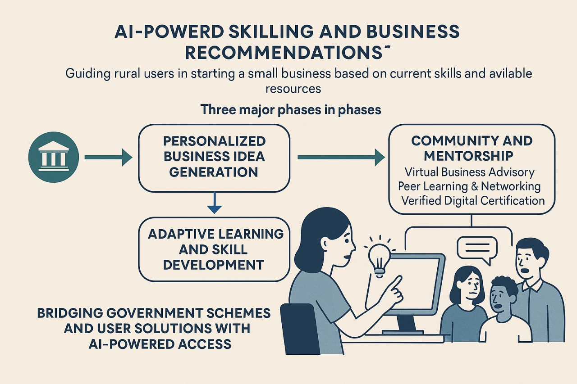
Describe your solution. How different is it from any of the other existing ideas? How will it be able to solve the problem? USP of the proposed solution? What is the intended impact of your solution (max 350 words).
Our AI-powered platform guides rural users from skills to sustainable livelihoods in four focused steps:
Business Ideas: Personalized micro-enterprise suggestions based on skills and resources.
CSR Skill Builder: Free, AI-augmented courses from corporate partners with progress tracking.
Job Matches: Curated, profile-aligned job listings with voice-enabled application support.
Community & Schemes: Peer forums, CSR-sponsored mentorship, plus an AI “Yojana Seeker” for easy government scheme access.

Slide 4
USP & Impact:
India has 378 million young people, two-thirds (≈ 252 M) living in rural areas—many disconnected from formal training and opportunity
TRI - Transform Rural India -There are over 57 million registered MSMEs employing 241 million people, yet countless entrepreneurs lack tailored guidance to grow their ventures
-Press Information Bureau.
Our two-sided CSR model taps into India’s ₹29,986.92 crore CSR spend in FY 23–24—across 1,367 listed companies—to deliver free, multilingual skill courses directly to underserved communities
-Mission sustainability, The Indian Express.
With 82.1 % of rural youth (age 15–24) now online, and an unemployment rate of 4.9 %, the digital delivery of AI-driven learning and opportunity matching is both feasible and urgent.
-Press Information Bureau, The Times of India.
By combining personalized AI learning, automated business-idea recommendations, government-scheme discovery, and corporate-driven courses, EmpowerUp can catalyse local entrepreneurship, drive job creation, and generate measurable social impact at scale.

Slide 5
Who is the primary user of your solution, and explain how your solution will leverage open-source AI to address the aspects mentioned in the Key Design Guidelines (max 200 words).
Our primary users are rural individuals from small villages and towns in India—often with limited formal education—seeking to improve their income through various means. Rural Indians face significant challenges in starting businesses, including:
A lack of personalized, hyper-localized guidance (e.g., "What crop-based business is best suited for my village?")
Difficulty accessing and navigating government schemes (e.g., SVEP, KVIC)
Limited availability of offline-first, voice-driven skill development resources in their native language.

Slide 6
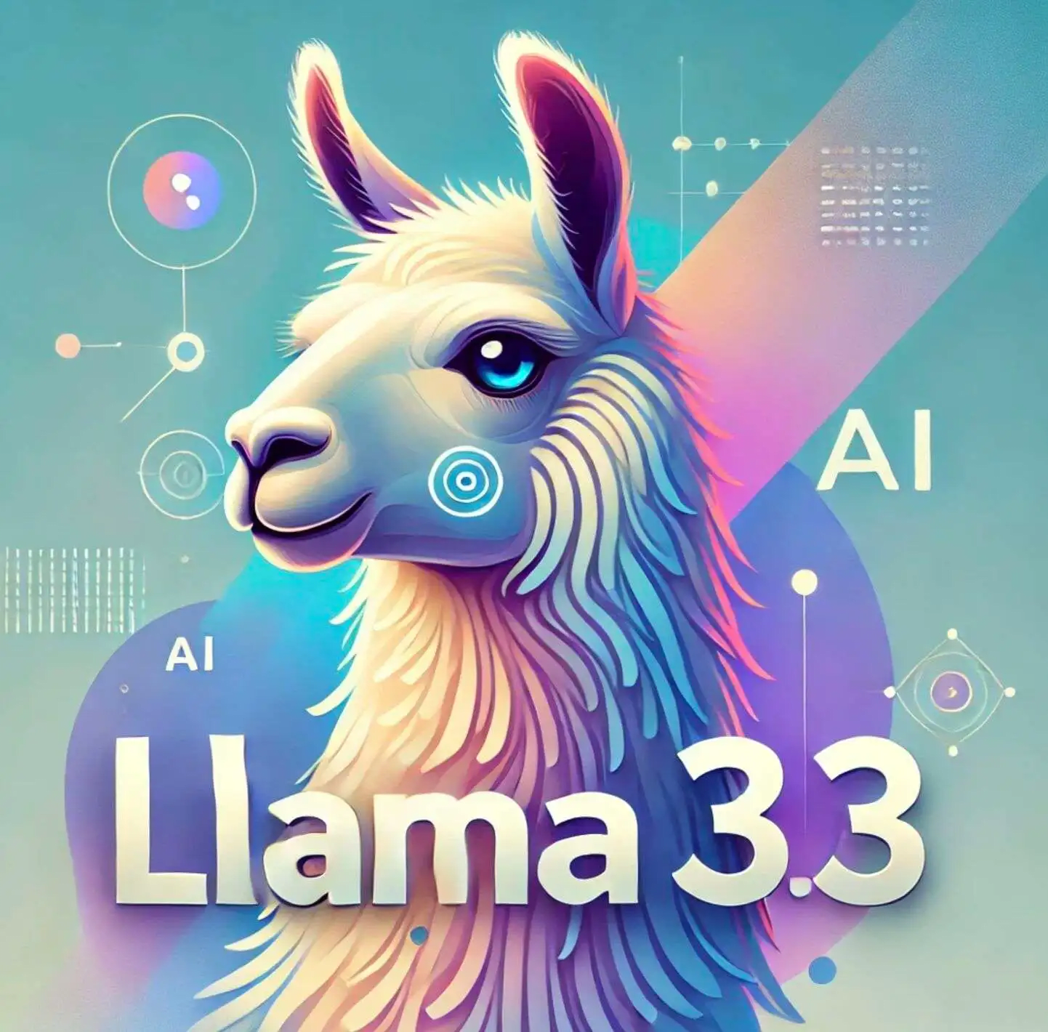

Leveraging Open-Source AI:
Our platform helps underprivileged individuals in small villages and towns start small businesses or find jobs based on their skills and available resources. We will use open-source AI to make the platform accessible, efficient, and cost-effective.
How AI Will Power Our Solution:
Smart Recommendations – Using AI4Bharat/Llama 3.3, our system will analyze user inputs in regional languages and suggest suitable businesses or jobs.
AI-Generated Learning Content – NLP models will create personalized scripts, while AI4Bharat & IndicConformer will generate voiceovers in local languages to make skill-building easy.
Networking & Support – Custom RAG will recommend mentors, financial aid, and government schemes to help users succeed.
By leveraging open-source AI, we ensure cost efficiency, transparency, and rapid innovation, making entrepreneurship and employment opportunities more accessible to the needy.

Slide 7
How is this solution scalable? (100 words max)
Our platform is highly scalable due to its AI-driven automation, modular architecture, and cloud-based deployment. Using open-source AI models, we can continuously improve recommendations and learning content without heavy infrastructure costs. Multilingual NLP and text-to-speech systems ensure easy expansion to different regions. Custom RAG based indexing allows efficient handling of large user databases, while cloud solutions enable seamless scaling as user demand grows. Additionally, AI-powered networking and government support features can be expanded dynamically. By leveraging community-driven open-source advancements, our solution remains adaptable, cost-effective, and capable of reaching millions across diverse geographies.

Slide 8
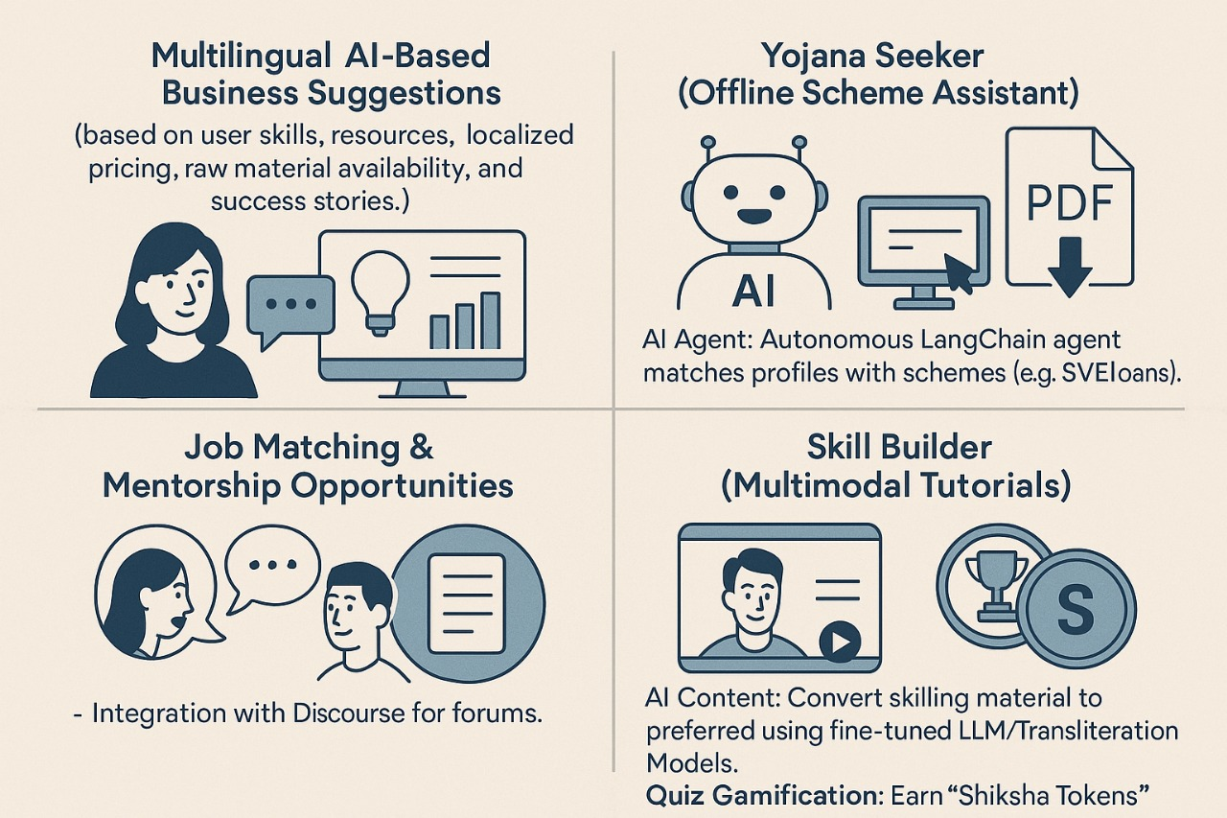
List of features offered by the solution
It is always better to add a few visual representations (drawings/sketches/illustrations etc.) to your presentation, it adds to the power through which it reaches the audience.
Features
1. Multilingual AI-Based Business Suggestions (based on user skills, resources, localized pricing, raw material availability, and success stories.)
2. Yojana Seeker (Scheme Assistant)
AI Agent: Autonomous LangChain agent matches profiles with schemes (e.g., SVEP loans).
Offline Forms: Downloadable PDFs with voice-guided instructions ("Step 1: Take Aadhaar card to panchayat office").
3. Job Matching & Mentorship Opportunities – Simple forums with Multilingual AI Search capabilities.
4. Skill Builder (Multimodal Tutorials)
AI Content: Convert skilling material to preferred language using fine-tuned LLM/Transliteration Models. Integration with corporate/government to create courses via CSR initiatives.
5. YouTube Video Audio Insights (Multilingual) Extracts and summarizes key insights from YouTube video audio in multiple languages, aiding content comprehension and discovery across literacy levels.

Slide 9
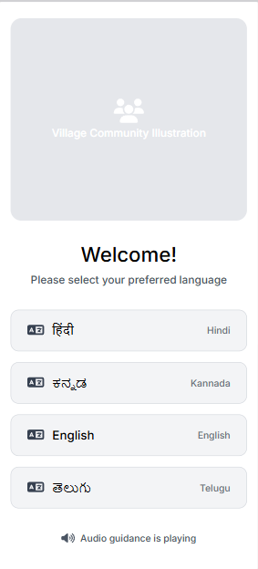
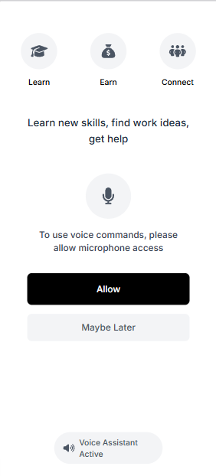
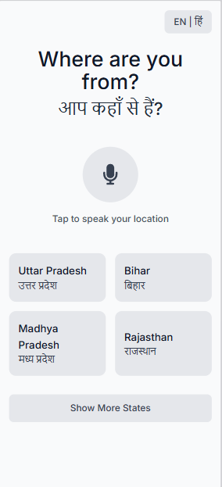
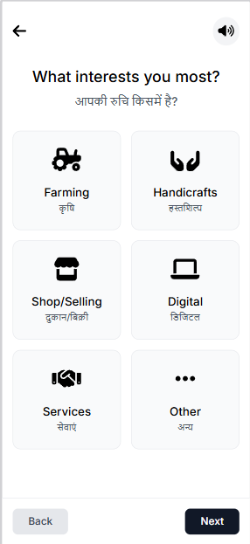
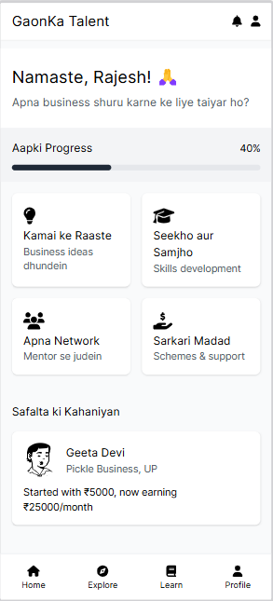
Please share the wireframes/Mock diagrams of the proposed solution

Slide 10
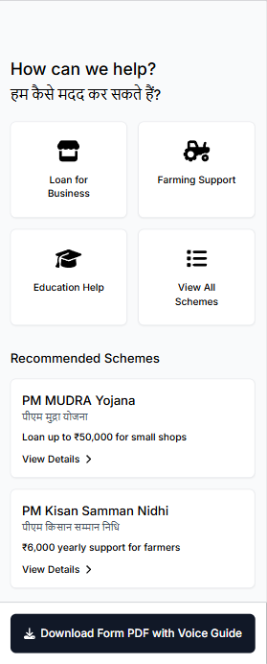
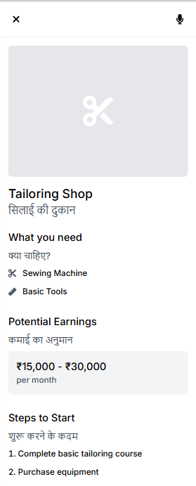
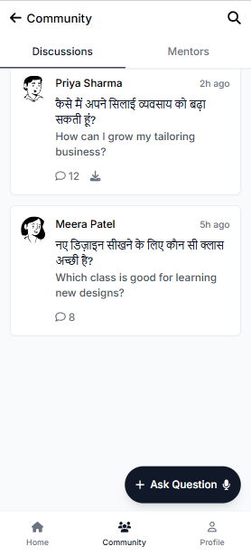
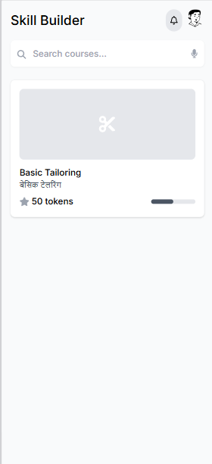
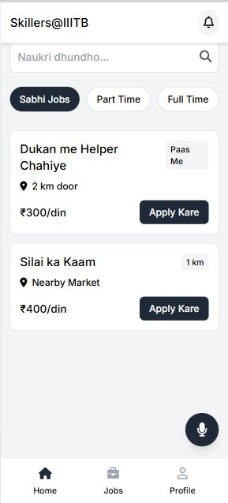
Government Schemes
Business Ideas
Community
Skilling
Job Finding

Slide 11
What open-source AI tools and technologies have you used to design the solution? (Please list all.)
Open-Source AI Tools & Technologies
1. NLP & Chatbot: Llama 3 , Llama 4 via Groq
2. Speech & Text Processing: Whisper via Groq, AI4Bharat – IndicTTS via E2E Networks
3. AI based Flash Cards Generation: Stable Diffusion 2.1 via E2E Networks
4. Frontend: React and Vite (Responsive for mobile)
5. Backend: FastAPI (Python)
6. Database: SQLite for lightweight
7. Deployment: Backend via Railway, and Frontend via Vercel

Slide 12
Why are these open-source technologies the most appropriate for your solution? (150 words max)
These open-source tools provide cost-effective and scalable solutions ideal for developing AI-driven applications, particularly in low-bandwidth and resource-constrained environments. Whisper and AI4Bharat’s ASR models enable automatic speech recognition, making interfaces more accessible to users with low literacy or limited digital experience. By converting spoken language to text accurately, these models bridge the gap between technology and underserved communities. Furthermore, the integration of Llama 4, a powerful language model, enhances the system's ability to understand and generate human-like responses across various contexts. Coupled with AI4Bharat’s Indic TTS (text-to-speech), the platform ensures natural-sounding audio feedback in multiple Indian languages. This multilingual support is crucial in a linguistically diverse country like India, enabling inclusive communication and broader outreach. The synergy of these tools empowers developers to build user-friendly, intelligent systems tailored to local needs, helping bridge digital divides and support social impact initiatives.

Slide 13
Our platform is designed to be lightweight, AI-driven, and optimized for users in low-connectivity regions, ensuring accessibility and ease of use. The architecture consists of five key layers: User Interface (PWA), Backend Layer, AI Layer, Skill-Building Content, and Community & Networking.
1. User Interface (PWA)
The platform is built as a Progressive Web App (PWA) using React + Vite, ensuring fast performance even on mediocore networks. It supports both text and voice-based interactions for accessibility.
Key Features:
Voice Interface:
Whisper (Speech-to-Text): Converts user voice inputs into text in 10+ Indian languages.
Indic TTS (Text-to-Speech): Provides audio guidance, making the platform user-friendly for those with low literacy.
Offline Support:
Service Workers & IndexedDB: Enable caching of content, allowing users to access resources, forums, and tutorials without additional API calls or waiting times.
Describe the Solutions Architecture (500 words)

Slide 14
2. Backend Layer
The backend is designed for efficient AI orchestration, fast API handling, and lightweight storage to ensure seamless performance.
Key Components:
AI Orchestration:
LangChain: Manages AI workflows for business recommendations, government scheme discovery, and auto-filling application forms.
FastAPI: Handles backend logic and API requests efficiently.
Database & Cloud Storage:
SQLite: A lightweight database used for storing user profiles, progress, and recommendations..

Slide 15
3. AI Layer
This layer powers Business Recommendations, Localized Insights, and Government Scheme Retrieval using Fine-Tuned AI models and Retrieval-Augmented Generation (RAG).
Key AI Components:
Llama-3-70B/Llama-4-Scout:
Connected with tool-calling to generate personalized business ideas based on user skills and resources.
Custom RAG with Llama:
Fetches relevant government schemes and localized data.
Ensures precise, real-time recommendations by retrieving knowledge from external sources.
data.gov.in/myscheme.gov.in Integration:
Retrieves real-time market trends, local commodity prices, and demand insights, allowing hyper-localized business suggestions.

Slide 16
4. Skill-Building Content
To help users develop the skills required for their suggested businesses, the platform includes AI-generated, offline-accessible learning materials.
Key Features:
Video-Like Tutorials:
AI-generated instructional content in multiple languages (textual and vocal), optimized for offline access.
Collaboration of corporate/government and skilling via CSR Initiatives:
Enables companies to fulfill CSR goals by offering free, multilingual skill courses to underserved communities. Organizations can publish content, track learner progress, and access transparent impact reports — all in one dashboard. The users can benefit from these industry-relevant courses. It’s a win-win relationship.

Slide 17
Data Flow
User Input:
Users speak or type their needs (e.g., "I want to start a tailoring business"). The AI auto-fills forms and information.
AI Processing:
Our platform processes inputs and generates personalized business recommendations, using localized data such as market prices from data.gov.in if needed.
Scheme Application:
AI auto-fills government forms and provides multilingual translations in the user’s preferred language to ease the application process.
Skill Development:
Users access offline tutorials and track progress, ensuring practical learning to kickstart their business or job.

Slide 18
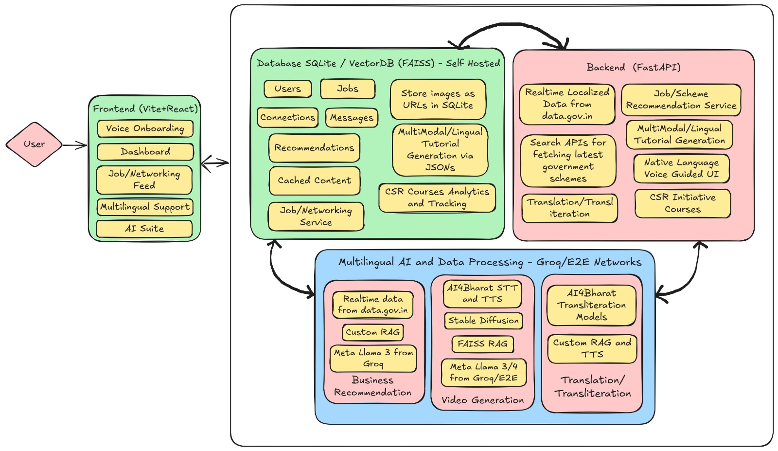
Provide a high-level architecture diagram or a use-case diagram of your proposed solution

Slide 19
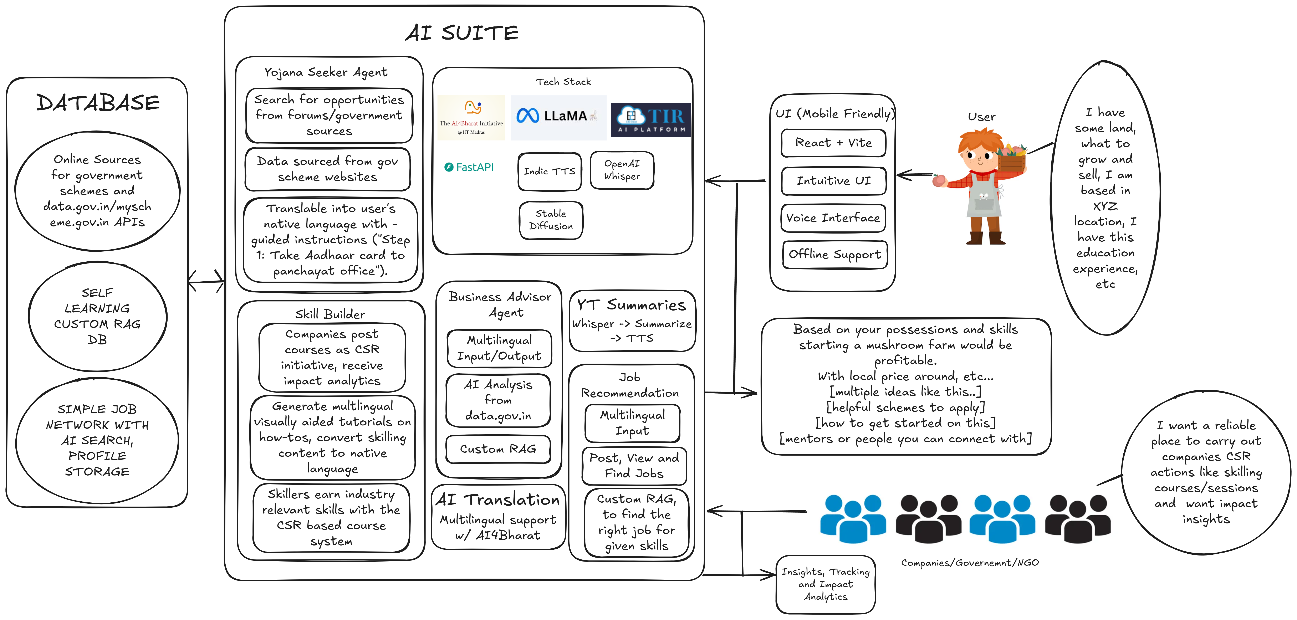

Slide 20
What datasets has your solution used? Are they publicly available, synthetic, or user-generated?
1. Our solution utilizes publicly available datasets sourced from data.gov.in and myscheme.gov.in. These platforms offer verified and structured information about various government schemes, their eligibility criteria, benefits, and application processes. The data from these sources is open for public use and forms the foundation for enabling real-time access to relevant schemes based on user input. No synthetic or user-generated data was used in our implementation.
2. User-Generated Data
Dynamic data from users will refine recommendations and improve learning of the RAG-powered recommendation system:
Skill & Resource Inputs – User-submitted data on their existing knowledge and tools.
Learning Progress & Feedback – User interactions with AI-generated content.
Community Engagement Data – Peer discussions, mentorship interactions, and networking data.
By combining public, and real-time user data, our platform ensures scalable, adaptive, and inclusive solutions for rural entrepreneurs.

Slide 21
Where will your solution be deployed (cloud, edge, on-device)?”
How will you address deployment challenges such as connectivity, cost, and scalability?
Our solution is deployed on the cloud using Railway, providing seamless access through a simple internet connection with no additional setup overhead. Its lightweight architecture makes it ideal for Railway’s free deployment tier, enabling us to minimize costs without sacrificing performance. The model is hosted on E2E, a cloud network service, which facilitates robust, end-to-end integration and smooth data handling across the system. Designed with a modular architecture, the solution is inherently scalable — each component can be independently updated, optimized, or expanded, simplifying both maintenance and long-term evolution. This modularity also enhances flexibility and allows rapid adaptation to changing requirements.

Slide 22
Deployment challenges such as connectivity, cost, and scalability are addressed holistically:
Connectivity is ensured through reliable cloud hosting and minimal client-side dependencies.
Cost is controlled by efficient resource use and free-tier deployment.
Scalability is supported by the decoupled design, enabling on-demand scaling of individual services without affecting the overall system.
This strategic deployment approach makes our solution agile, cost-effective, and ready for both immediate use and future growth.

Slide 23
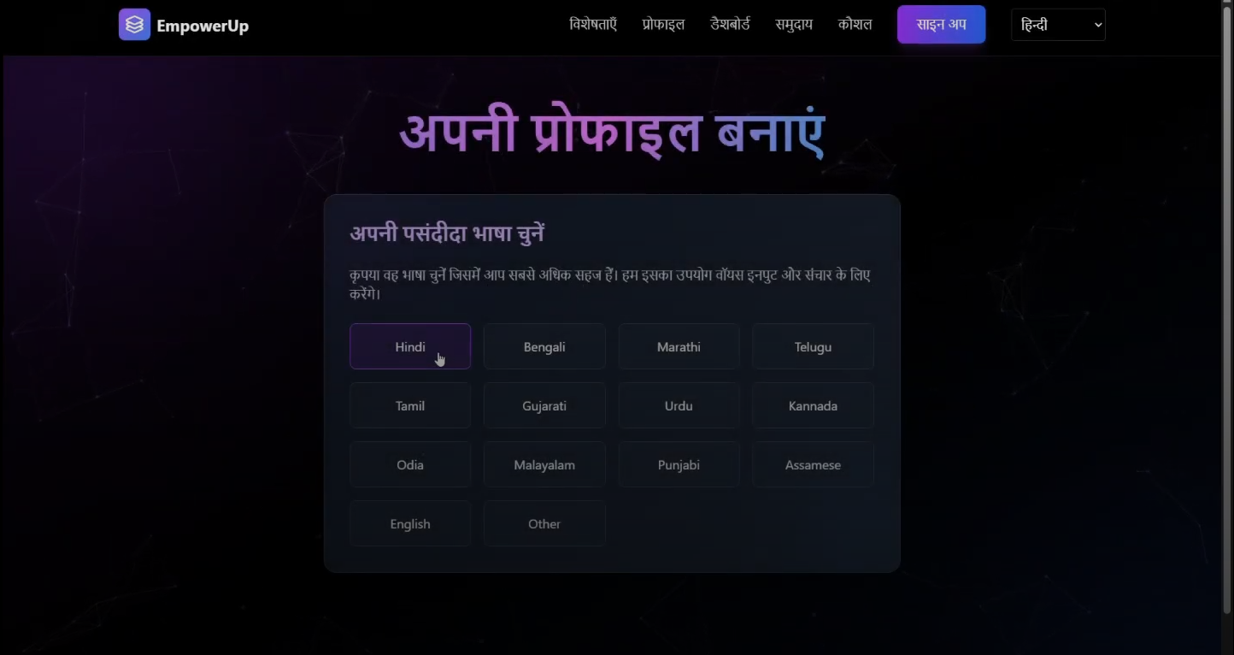
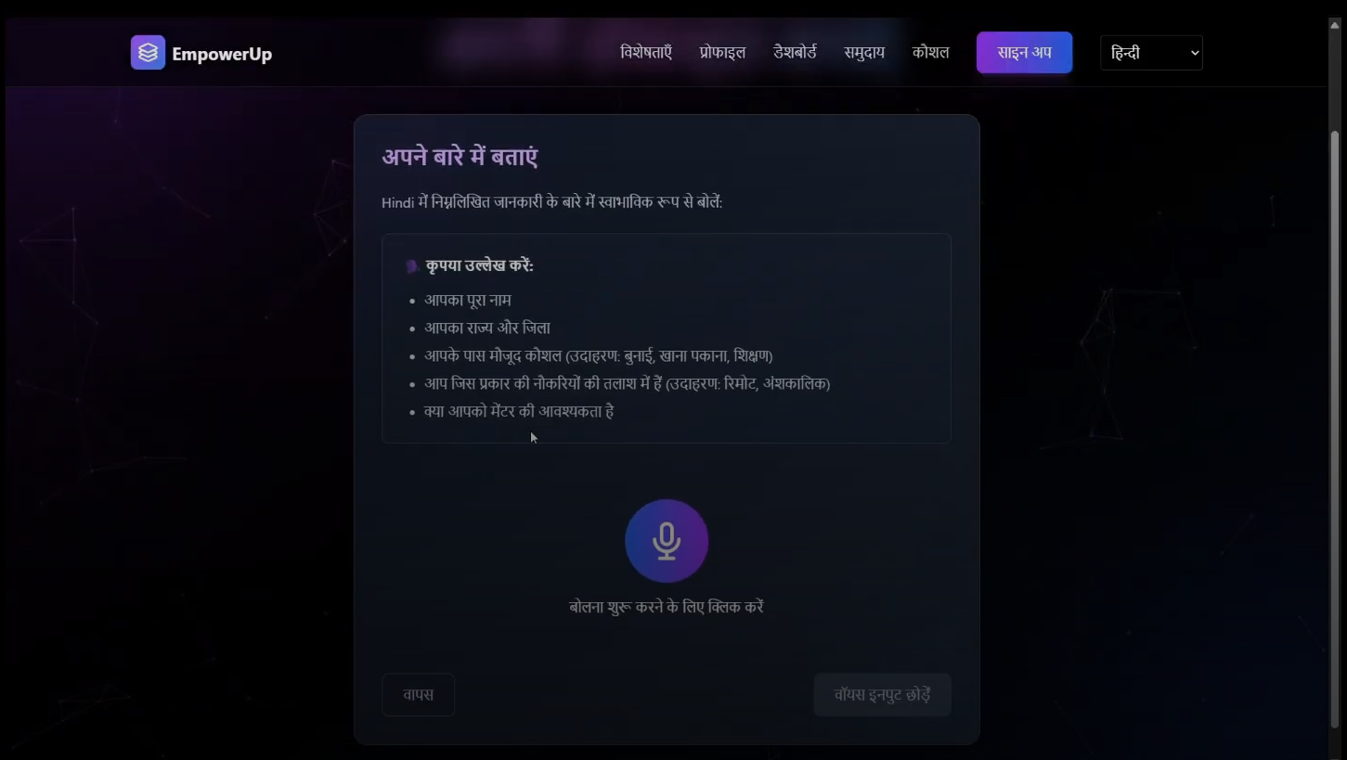
Snapshots of prototype
Profile making

Slide 24
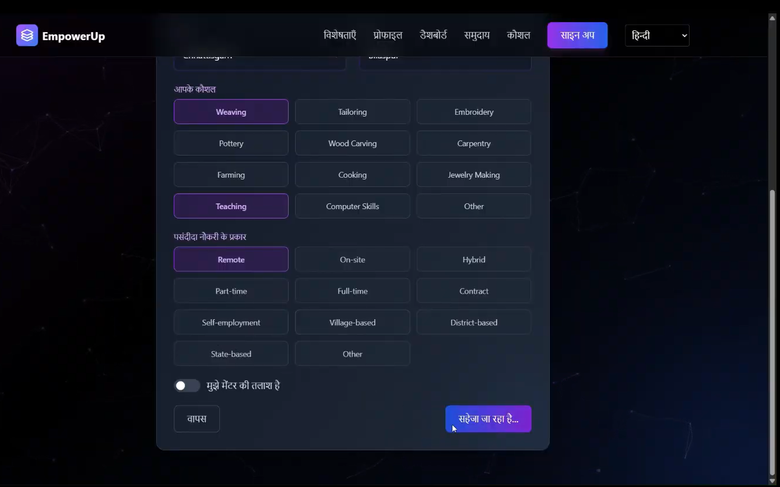
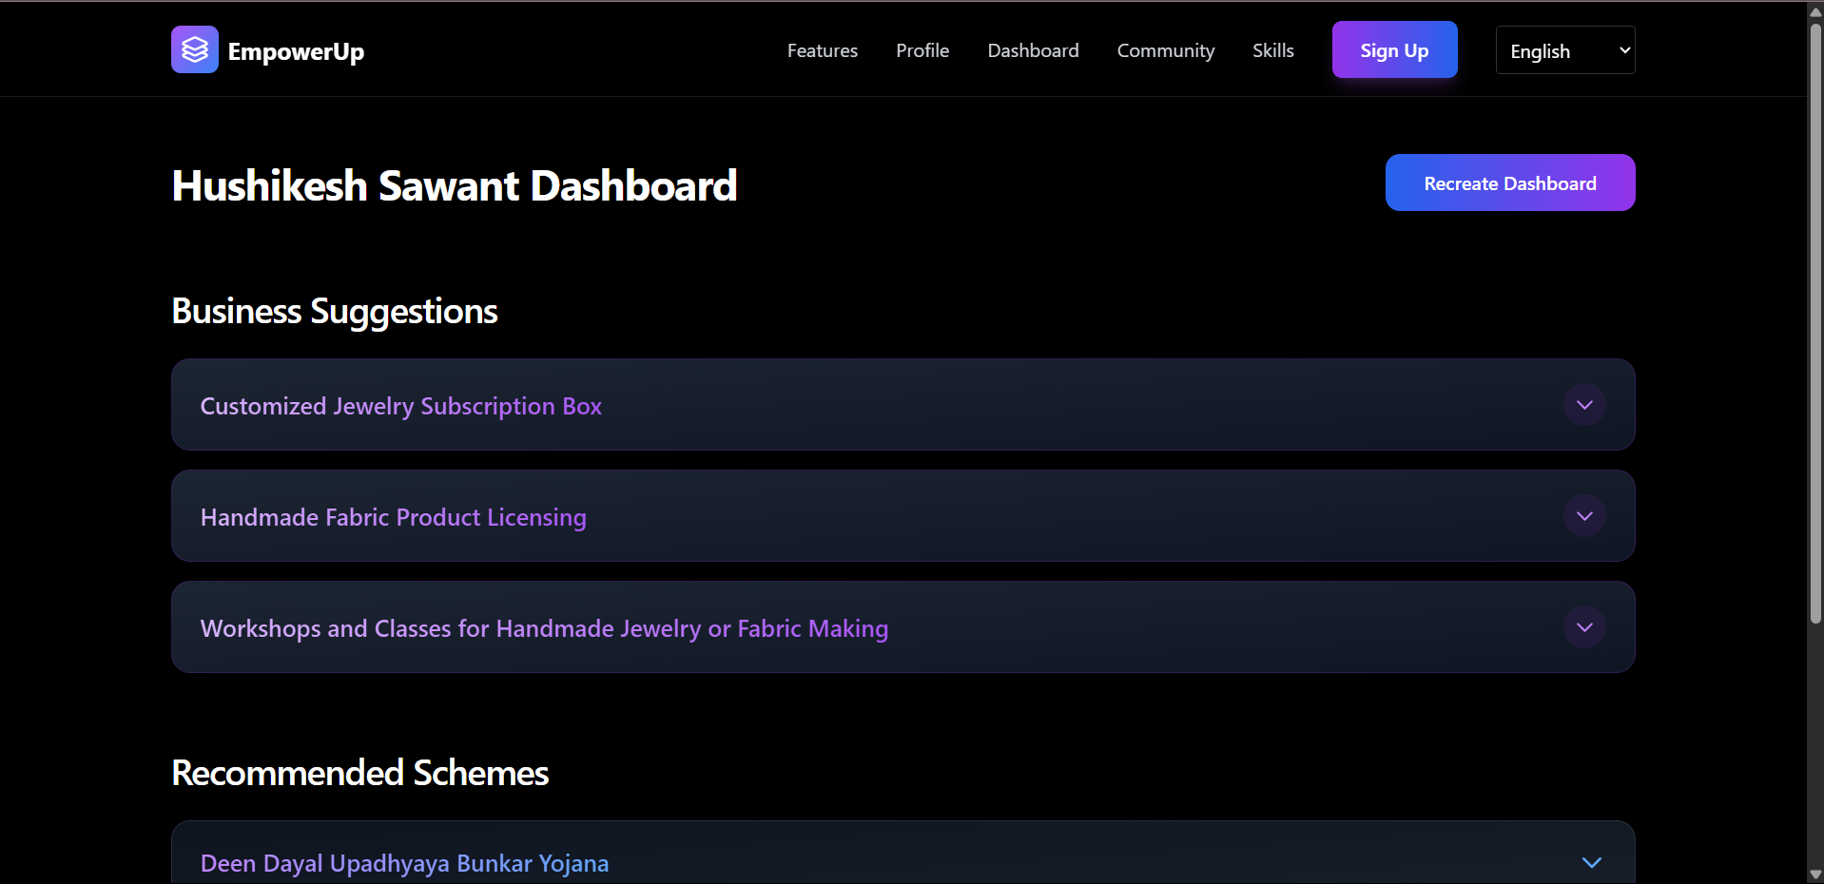
Personalised Dashboard

Slide 25
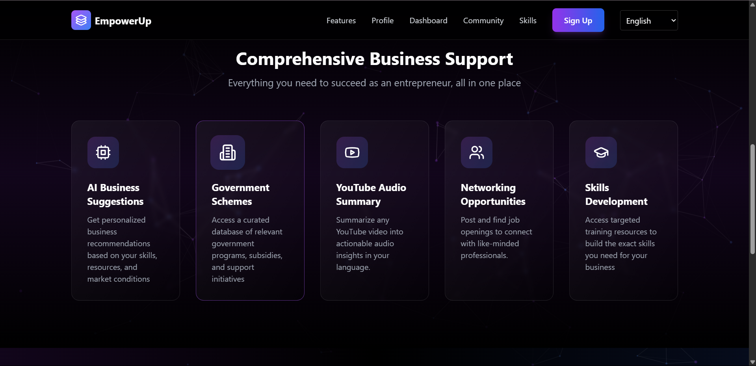
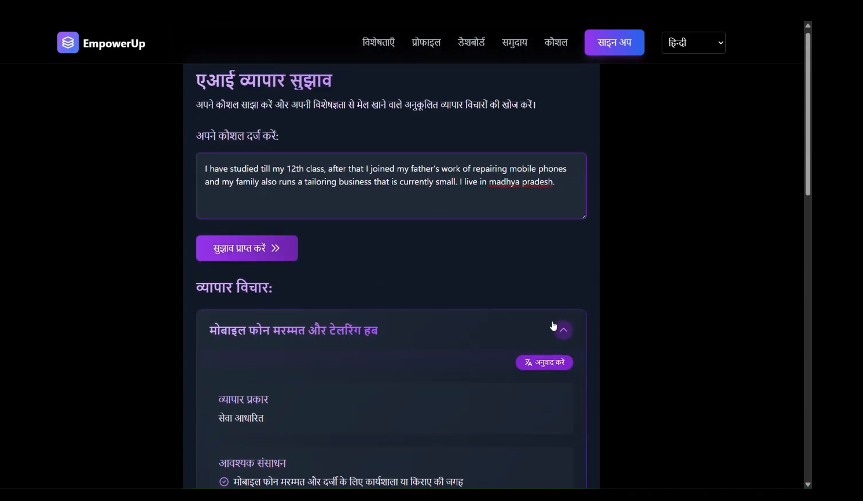
Features AI Business Suggestions

Slide 26
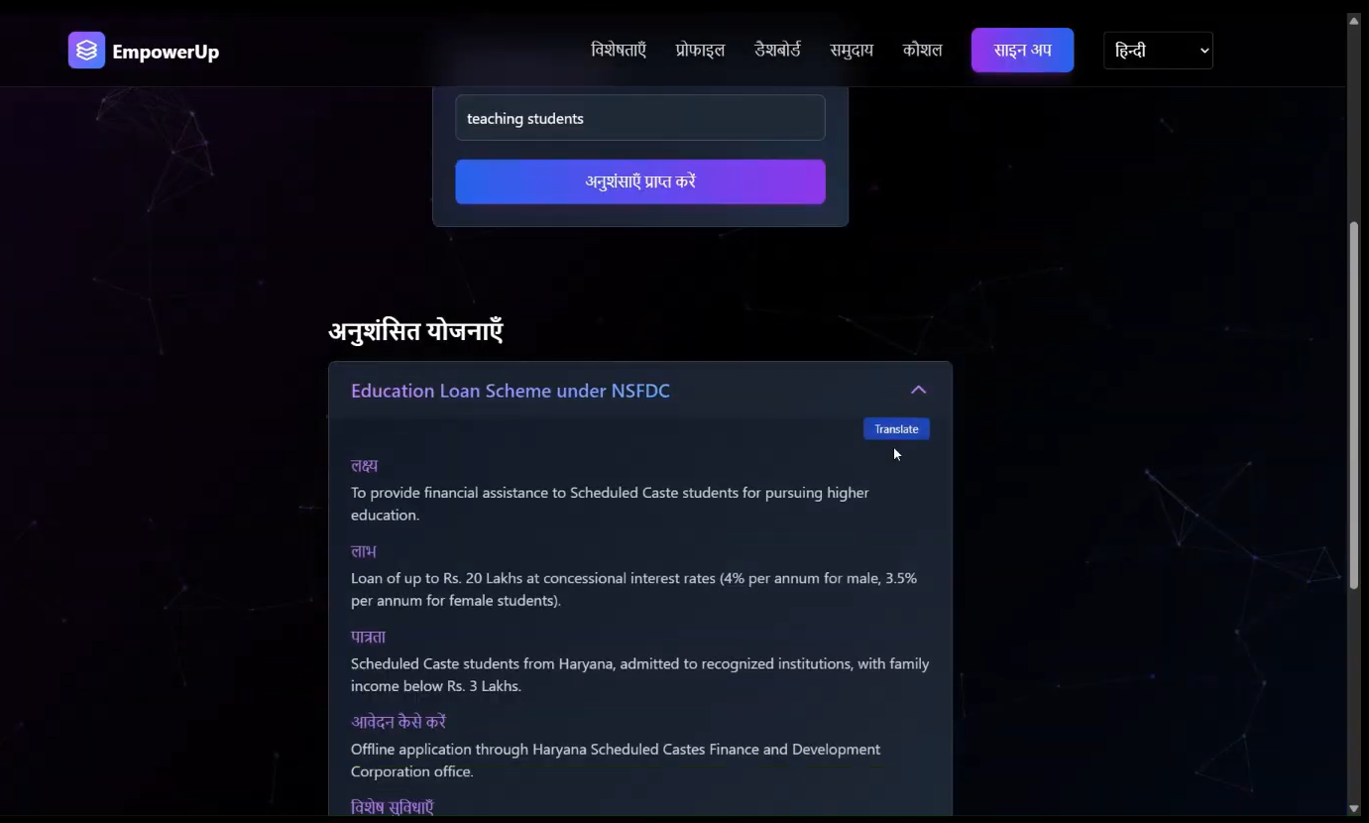
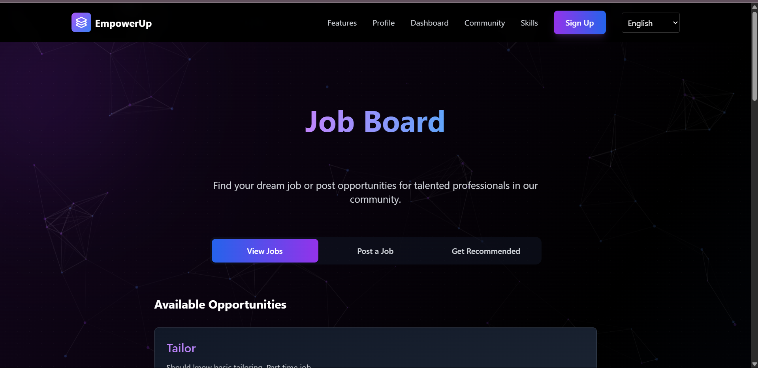
Government Scheme Recommender Job Board for guided job assistance

Slide 27
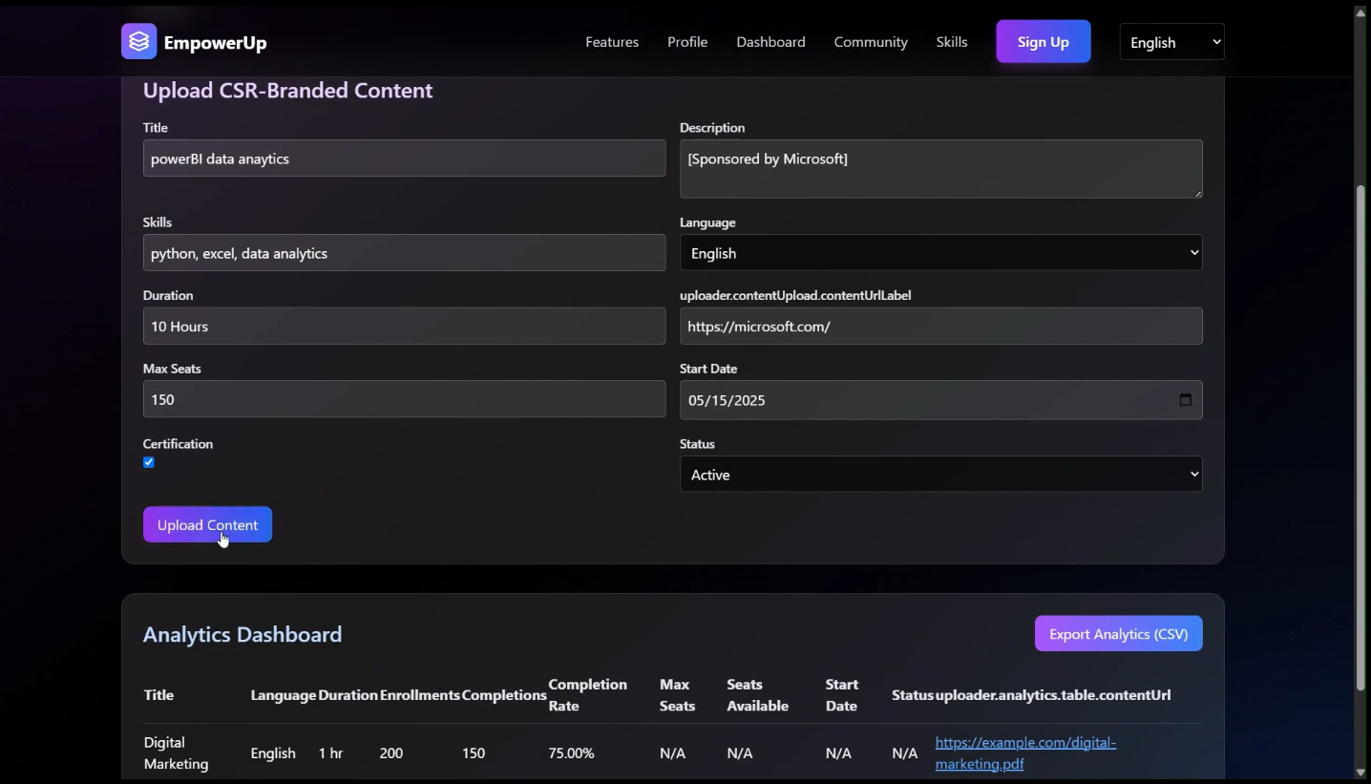
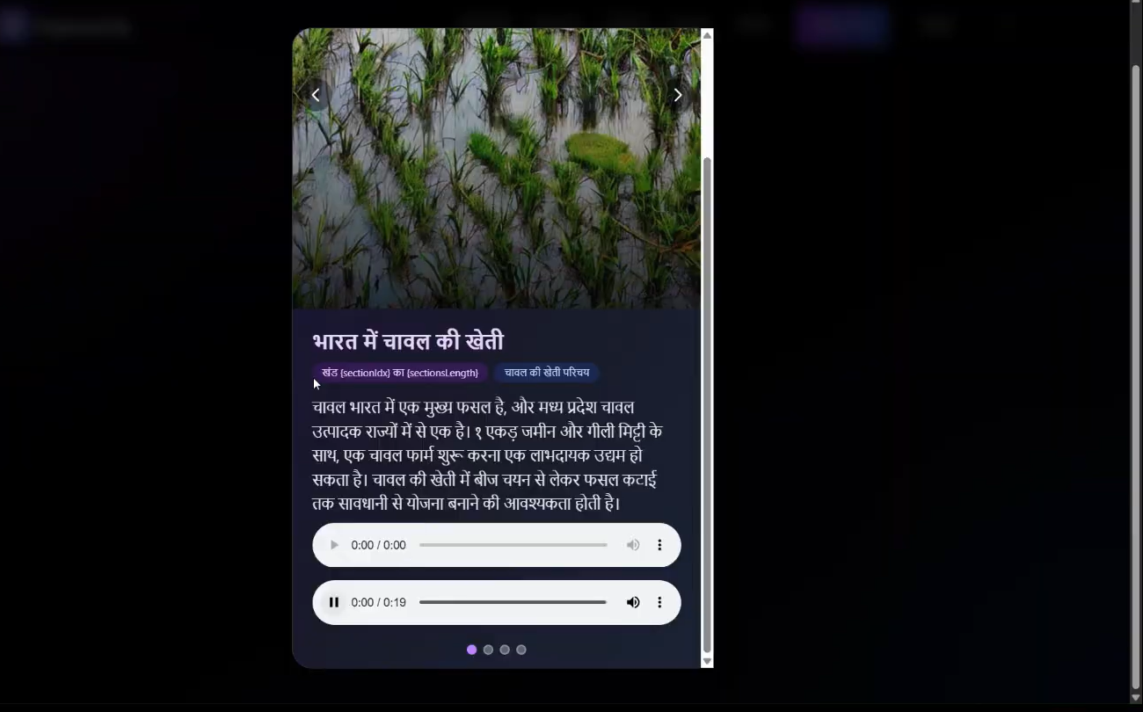
Skills Section Visual summary with audio support

Slide 28
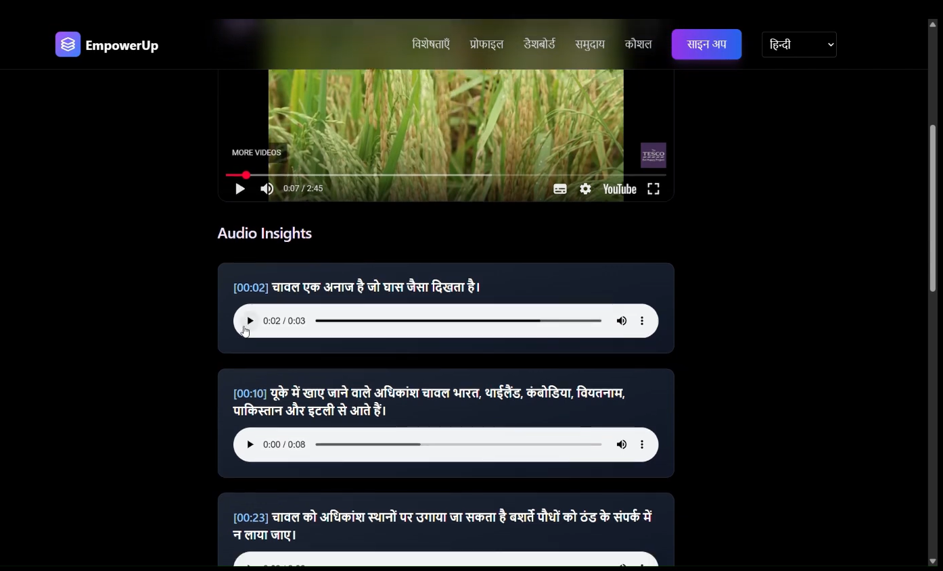
Multilingual YouTube audio insights

Slide 29
Planned future enhancements or scalability considerations
We have several strategic enhancements and scalability considerations planned to strengthen both user experience and system robustness:
Voice-Operated Assistant: We're integrating a fully voice-controlled assistant to make the platform more accessible and intuitive. This will allow users to interact with the system hands-free, improving usability for visually impaired users and enabling multitasking.
Offline Functionality via Local Storage: To improve reliability and accessibility, we plan to utilize local storage capabilities within the browser or device. This enhancement will enable key features to work even without an active internet connection, ensuring uninterrupted access in low-connectivity environments.
Modular Scalability: The platform follows a modular architecture, which will continue to support horizontal scaling as user demand increases. Services such as authentication, database, and model inference can be independently scaled based on real-time usage metrics.
Cloud-Based Expansion: As the user base grows, we intend to leverage scalable infrastructure using cloud orchestration tools to enable load balancing, autoscaling, and real-time monitoring. This ensures consistent performance regardless of scale.
These enhancements are aimed at making the platform more intelligent, reliable, accessible, and scalable, ensuring it continues to meet evolving user needs and technical demands.

Slide 30
Provide links to your:
- GitHub Public Repository
- Demo Video Link: A short video (3-5 minutes) demonstrating the prototype.
- MVP Link: Link to your functional prototype.
GitHub Public Repository : https://github.com/Hrushi199/GramUdyogAI
Demo Video Link : https://drive.google.com/drive/folders/1QKelo5SbGAmZt0l2CB0qfO13mmBV6Muw?usp=sharing
MVP Link : https://gramudyog-pragati-meta-jaab.vercel.app/

Slide 31
